Slide 1
Automatic Network Packet Generation Interface
Michael (Seth) Heinzman

Slide 2
CONTENTS
Folder Structure
Network Package with Scapy
Class Diagrams of PyQt Project
Testing
Demo
Conclusion

Slide 3
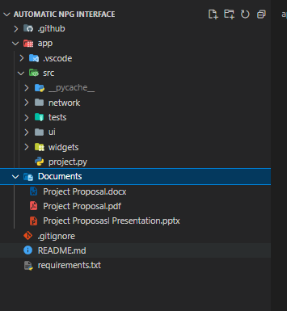
Folder Structure

Slide 4
Network Package with Scapy

Slide 5
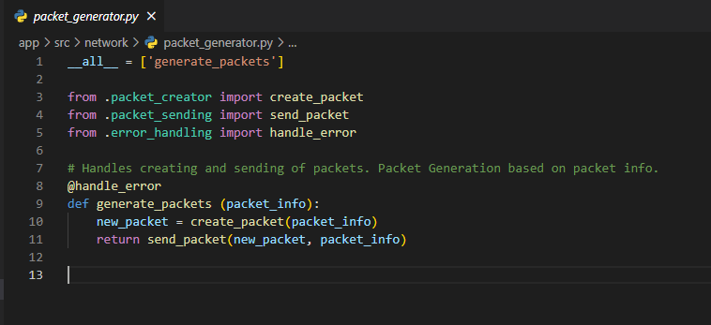
Packet Generator
Responsible for the creation and sending of a packet.
Input
Packet information
Output
Sent, Received, and Unanswered packets.

Slide 6
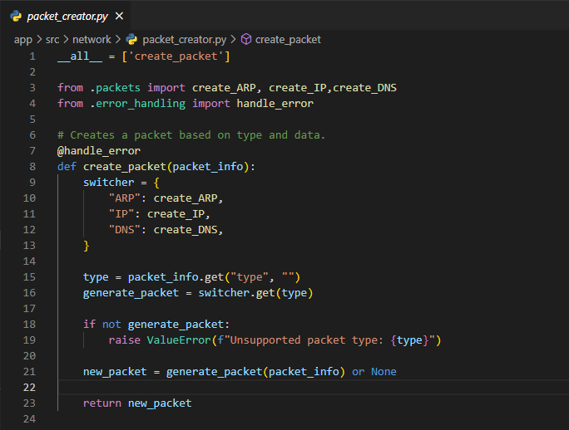
Packet Creator
Responsible for the creation of a packet based on packet information provided.
Input
Packet information
Output
Created Packet.

Slide 7
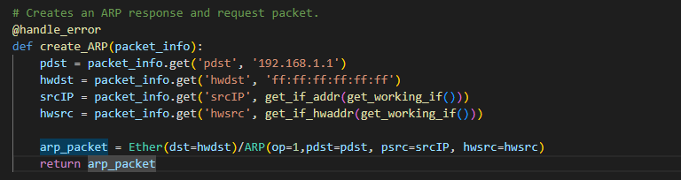
ARP Packet Creation
Input
Packet Information specific to ARP Packets.
Output
ARP Packet

Slide 8
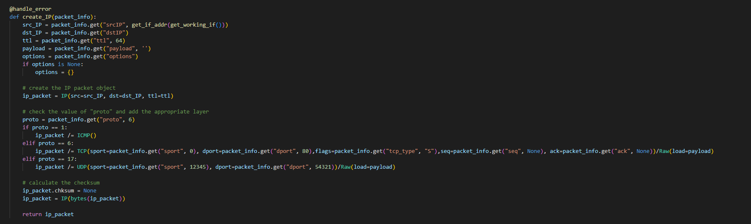
IP Packet Creation
Input
Packet Information specific to IP Packets.
Output
IP Packet

Slide 9
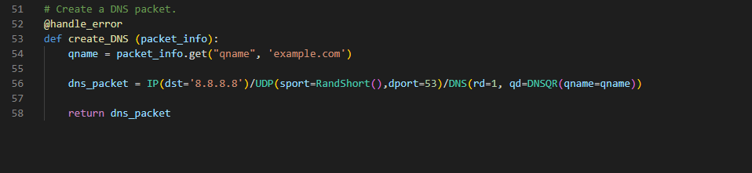
DNS Packet Creation
Input
Packet Information specific to DNS Packets.
Output
DNS Packet

Slide 10
Packet Sending
Consists of three functions
send_packet(created_packet, packet_info)
Returns a tuple of answered, unanswered, sent packets
Check_packet_type_assign_send_method(packet, packet_info)
Returns the scapy send method for the specified packet and the interface.
Get_default_interface_name()
Returns the default network interface to send packets on.

Slide 11
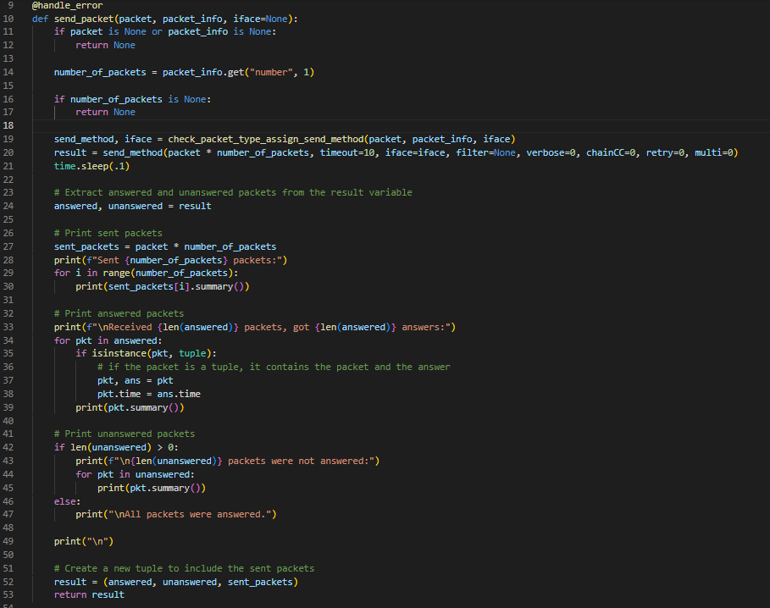
Send Packet

Slide 12
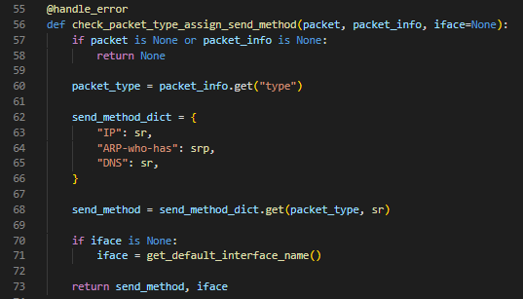
Check Packet and Assign Send Method

Slide 13
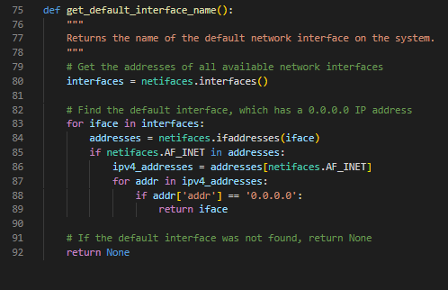
Check Packet and Assign Send Method

Slide 14
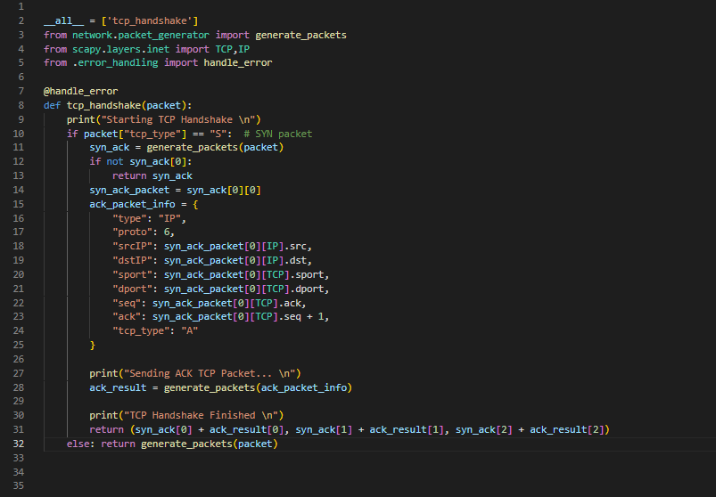
TCP Handshake

Slide 15
Exporting Packet Generation Results
Export To Wireshark
Create a PCAP file from packet generation results
Download PCAP file from packet generation results
Move to Selected Folder

Slide 16
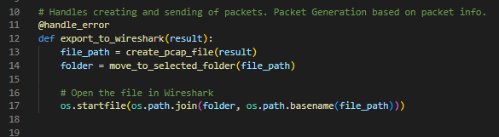
Export To Wireshark

Slide 17
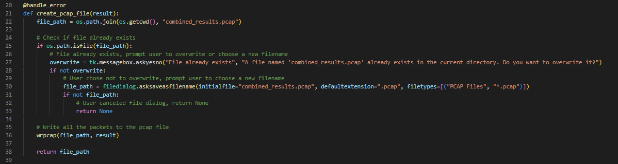
Creating a PCAP File From Results

Slide 18
Testing with Github

Slide 19
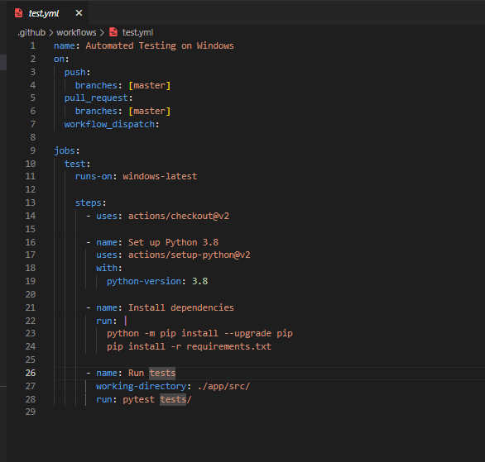
Test.yml for Github Actions

Slide 20
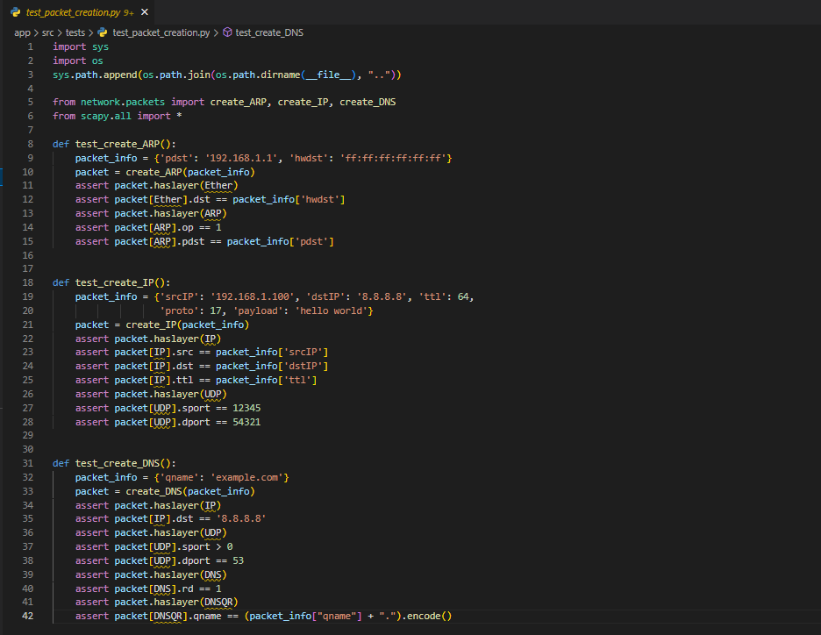
Example Test Case

Slide 21
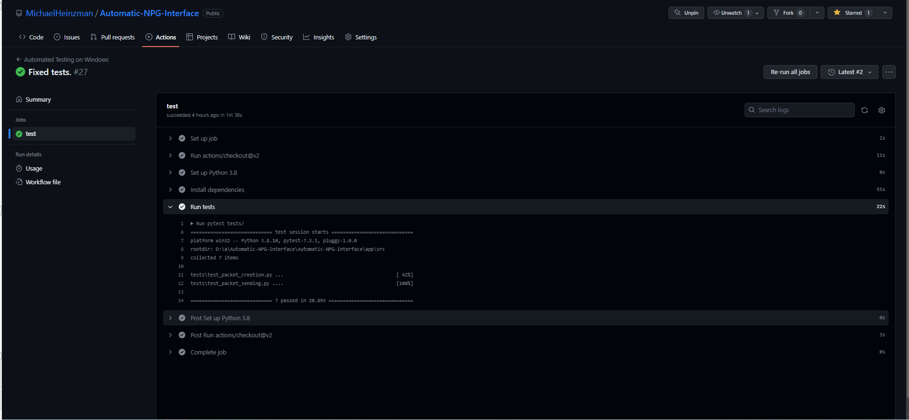
Output on Github

Slide 22
Demo

Slide 23
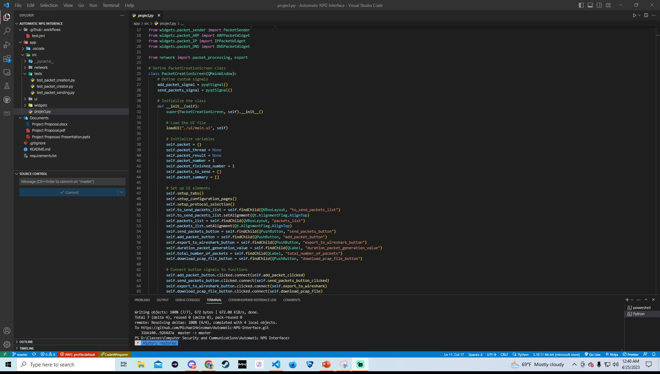

Slide 24
Conclusion

Slide 25
Conclusion
Things I learned…
Research Scapy functions beforehand and what they can do before I start coding. Could have reduced so much time and frustration if I put in the research.
For example, I spent a few days implementing threading into PyQt when Scapy had a parameter when sending packets that automatically threaded the sending of the packets.
Put more effort into the design of the project and the use cases. The use cases and design ended up not being specific enough which caused me to spend greater amounts of time coding to fix issues that I dug myself into with poor design.
Overall, it was a fun project and I learned tons of information about how network packets work and what they need to be sent and created.

Slide 26
Any Questions?

